Slide 1
ECE 143 Team 6
UCSD Summer Session Analytics
Albert Tan
Alex Ng
Derek Lee
Yancong Deng
Notes:
All of us

Slide 2
Project Overview
Objective
Data Scraping and Limitations of the Dataset
Summer and Non-Summer Course Comparisons
Analysis of Summer Course Data
Notes:
Derek
There are four main sections of our presentation. The first is the objective of the presentation. The second is the procedure for scraping data and the limitations of the dataset. The third is the comparison between summer and non summer counterparts, and the last is the analysis of our data

Slide 3
Objective
How do summer courses differ from their non-summer courses?
GPA and study hours
class-sizes
recommendation rates
Predict summer GPA based on non-summer GPA counterpart
Is there any correlation between the data given by CAPE, such as professor recommendations, grades received, and hours spent studying?
Notes:
Derek
So here is our objective. based upon the average gpa, hours studied, class sizes, and recommendation rates, we attempt to find a difference between summer courses and their non summer courses. Also, based on our data, can we predict summer gpa from the gpa of its non summer class, and also are there any correlations in our data

Slide 4
Data Clustering
Collect UCSD Aggregate data
Cluster into 3 Disciplines (Engineering, Humanities, Social Sciences)
Divide each discipline into 5 biggest departments within each discipline
UCSD Aggregate
Engineering
CSE
ECE
MAE
SE
NANO
2. Humanities
PHIL
HIEA
MUS
TD
VIS
3. Social Sciences
ECON
POLI
COGS
PSYC
MGS
Notes:
Derek
This slide is how we aggregated the data. While scraping the data we filtered the data into 3 disciplines which are engineering, humanities and the social sciences. We also only took data from the 5 largest departments in each discipline. For example Engineering data would only include CSE, ECE, MAE, SE, and NANO. The reasoning for only doing the five largest is because once we got to smaller departments, those departments often did not have any classes with summer courses.
Intuitive clustering, we do analysis on each of the three disciplines later on

Slide 5
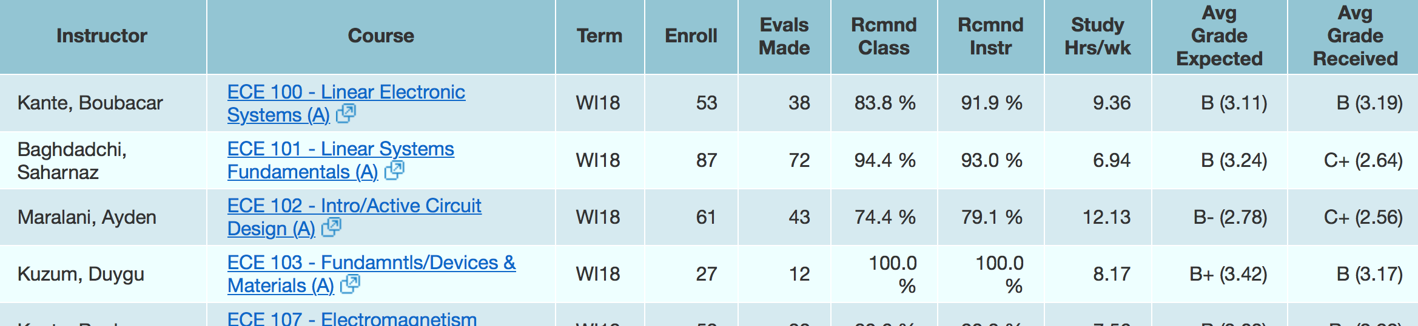
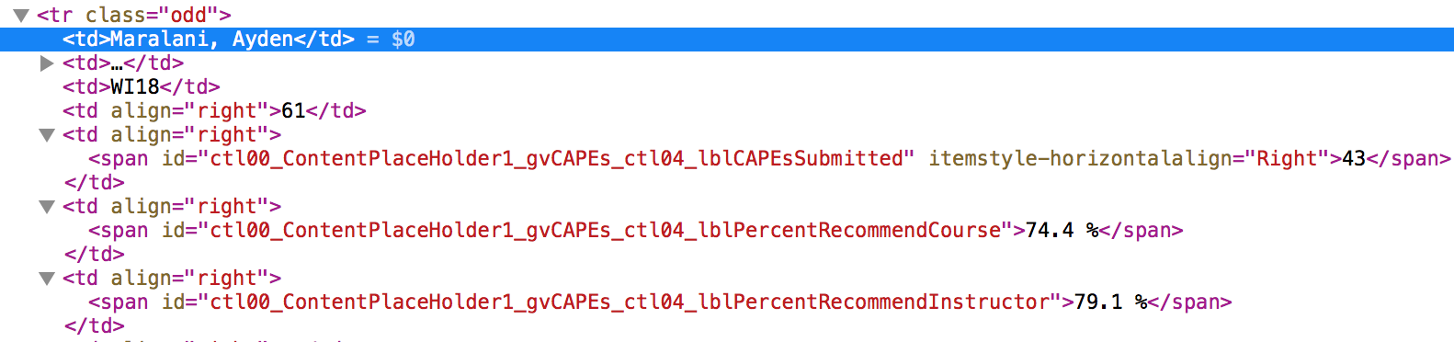
Data Source - cape.ucsd.edu
Notes:
Derek
This is an example of a webpage that we would scrape, the top is the cape website and the bottom is its html. All the data in the html is stored in one giant table. We used beautiful soup and python to go through the rows and columns for all of the data.

Slide 6
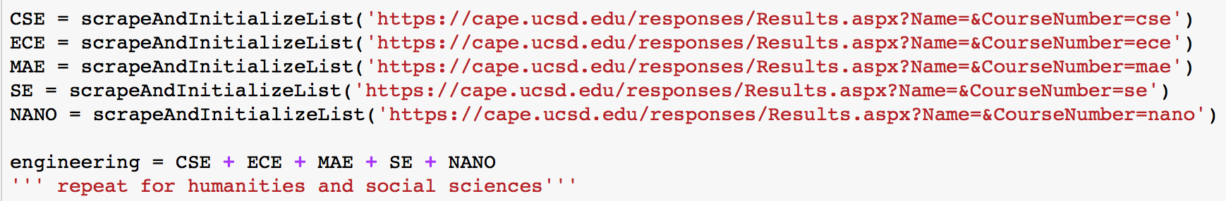
Data Scraping
Store URL’s for each of the 15 departments
For each URL: append all rows from html table using BeautifulSoup
Filter out:
courses before 2011
courses that don’t have a summer session counterpart
courses that have N/A CAPE reports
Concatenate into 3 Disciplines (Engineering, Humanities, Social Sciences)
Notes:
Derek - Here is our procedure for scraping the data. We took the urls for the 15 departments, 5 for each discipline, and we used beautifulsoup to get all the rows. Then, we filtered out all the courses with not applicable cape reports, courses without a summer counterpart, and all of the courses before 2011. This is because before 2011 there was no data for summer session courses. Then we concatenated all of the data from each discipline into one large variable. The bottom is our code for ECE. This code is similar for humanities and the social sciences. Only the urls and variables are different.

Slide 7
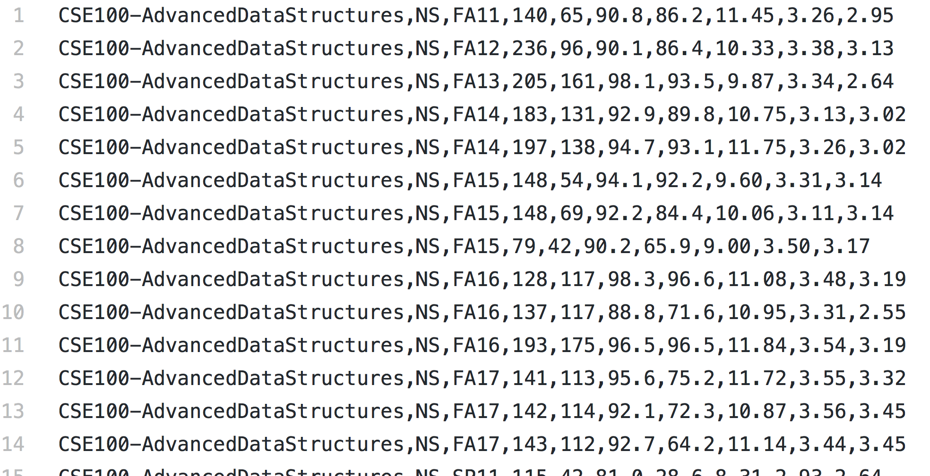
Writing to txt/csv file
converted from python Lists
row formatting like CAPE
comma separated columns
input into Pandas
screenshot: small portion of engineering.txt
Notes:
Derek - After scraping and then filtering all of the data, we exported it into text files. Here is a small section of our engineering text file. Each line contains a class’s data separated by commas. This data is then input into pandas for further processing

Slide 8
Limitations of the Dataset
Incomplete data (N/A for received grades, expected grades, etc.)
Only data for summer classes after 2011
Low evaluation response rate for some summer courses
Notes:
albert

Slide 9
Summer and Non-Summer Course Comparisons
Notes:
alb

Slide 10
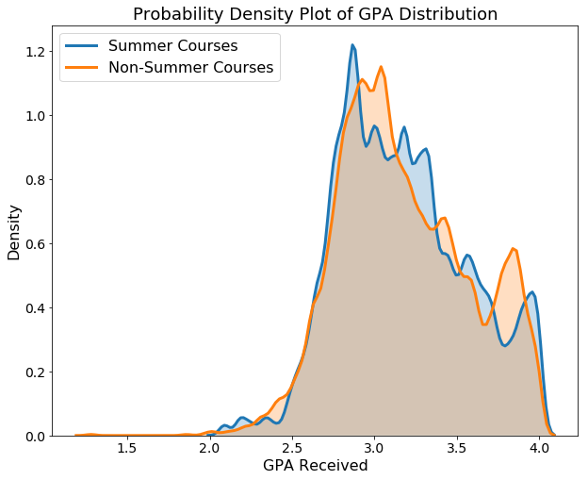
Density Distribution of GPA Received: UCSD Aggregate
Notes:
alb

Slide 11
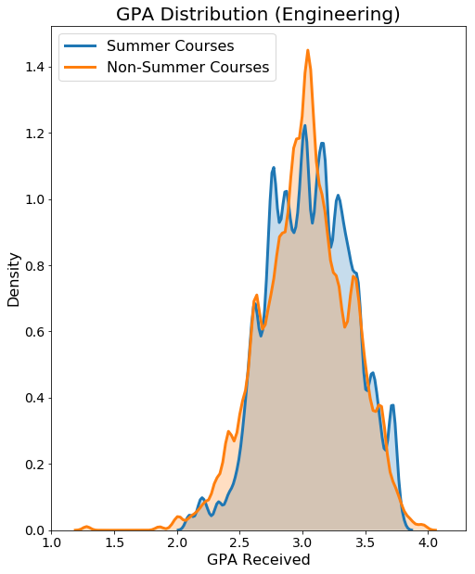
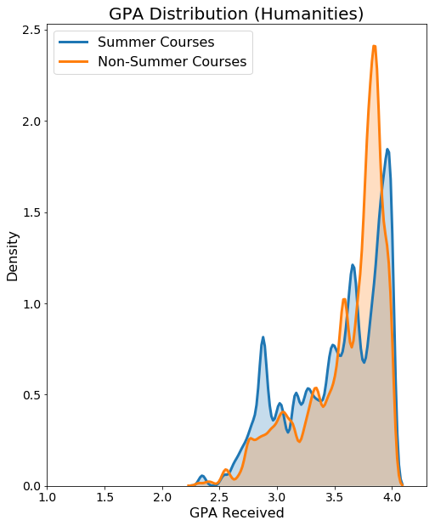
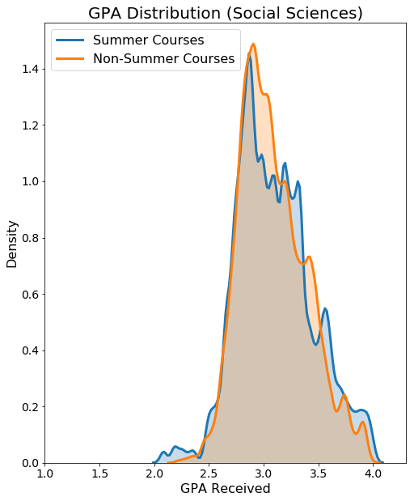
Density Distributions Across Each Major Discipline
Notes:
alb

Slide 12
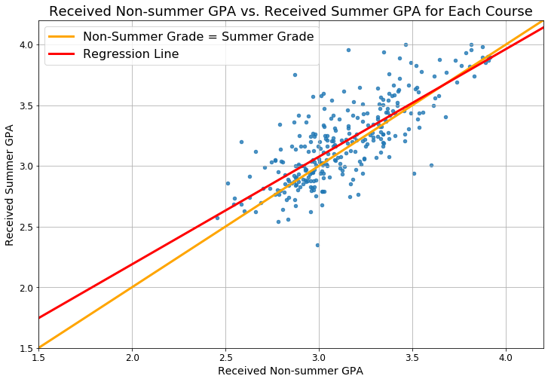
Relationship between UCSD Summer GPA and Non-Summer GPA
r² value: 0.5948
p value: 4.845e-58
S_GPA = 0.89*NS_GPA + 0.42
NS GPA | S GPA
2.0 (C) | 2.2
2.3 (C+) | 2.5
2.7 (B-) | 2.8
3.0 (B) | 3.1
3.3 (B+) | 3.3
3.7 (A-) | 3.7
4.0 (A) | 4.0
Notes:
Albert
r^2 is regression.
R is correlation
The data is decently well-fitted to the regression line.

Slide 13
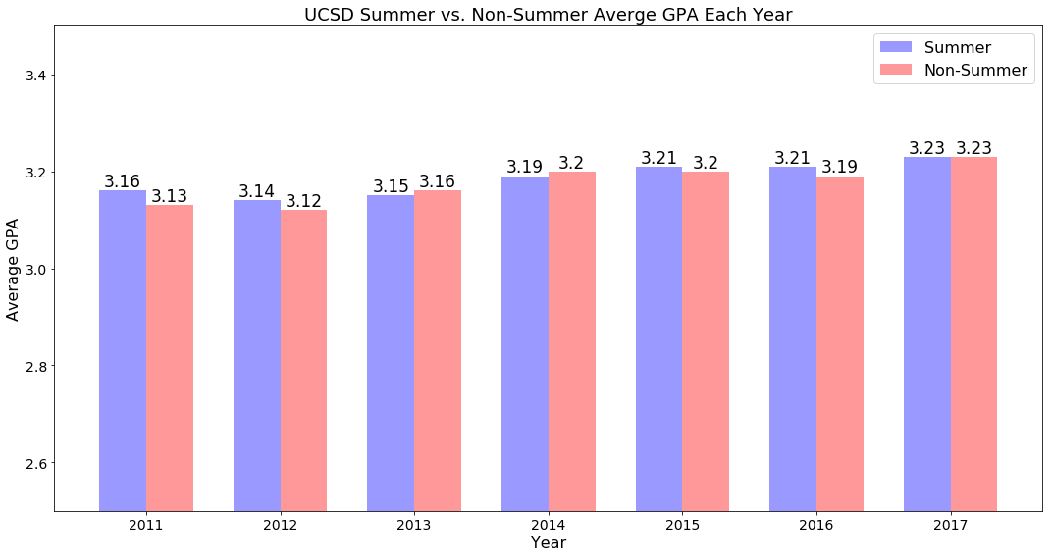
Average UCSD Grades Received By Year
Notes:
yan

Slide 14
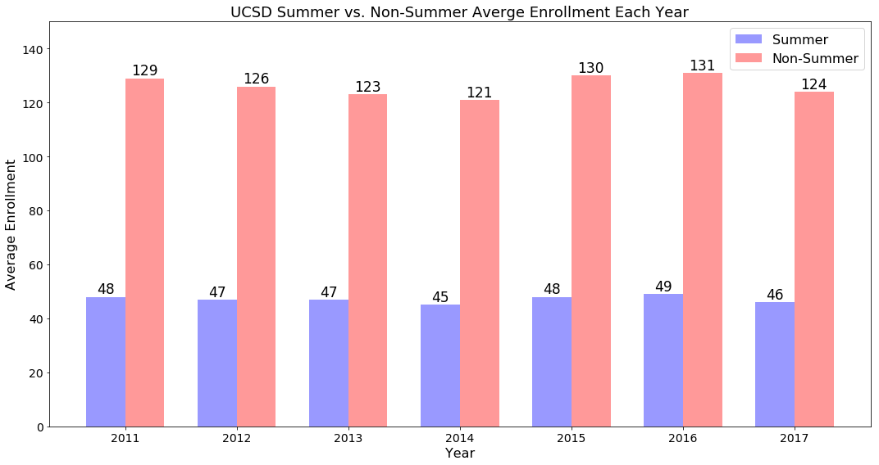
Average UCSD Course Enrollment
Notes:
yan

Slide 15
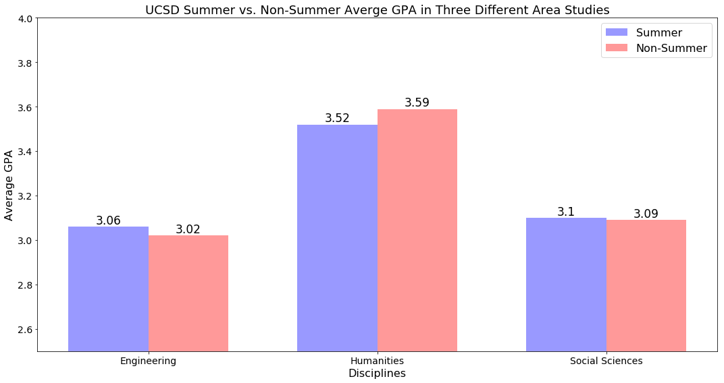
Overall GPA in Different Disciplines
(Summer vs. Non-Summer)
Notes:
yan

Slide 16
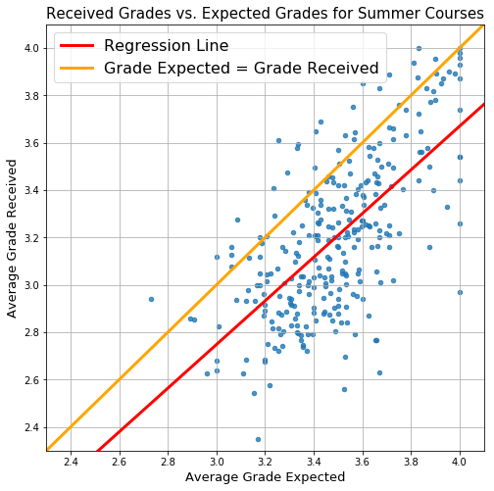
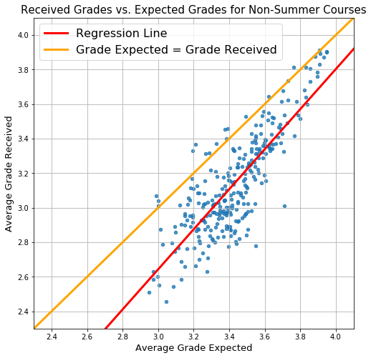
Relationship between UCSD Expected and Received Grades
Slope: 0.9218, Intercept: -0.0175
r value: 0.6614, p value: 1.3498e-37
Slope: 1.1598, Intercept: -0.8364
r value: 0.8211, p value: 1.2741e-71
Notes:
Alex
Both have a strong correlation (>0.5)
Yellow line indicates where expected gpa matches the received gpa
Non-summer is obviously more correlated than summer. Could be due to a number of different factors (lack of data, unfamiliarity with the professor)

Slide 17
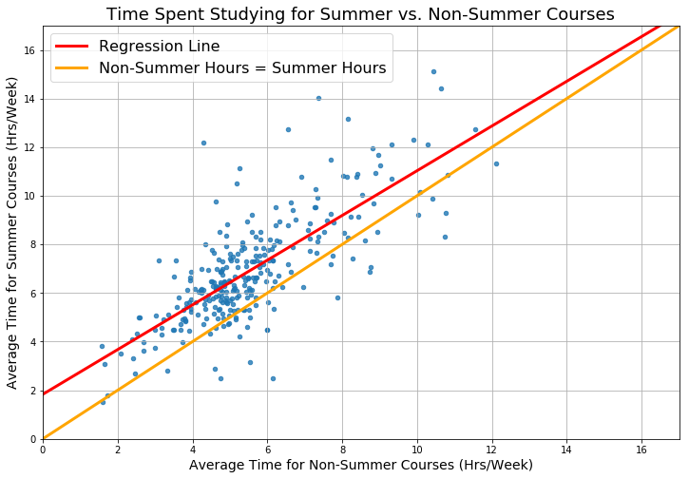
Time Commitment of UCSD Courses
Slope: 0.9198, Intercept: 1.8321
r value: 0.7621, p value: 6.2827e-56
Notes:
Alex
Spend more time studying per week during the summer. Makes sense because the courses are more condensed.

Slide 18
Analysis of Summer CAPE Survey Responses
Notes:
alex

Slide 19
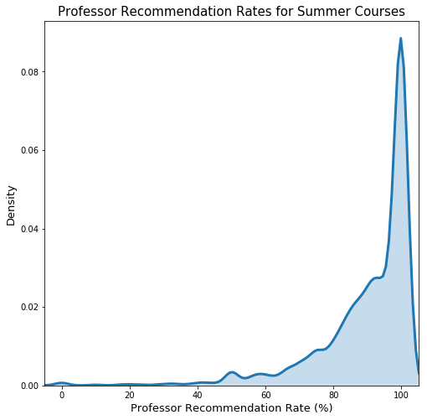
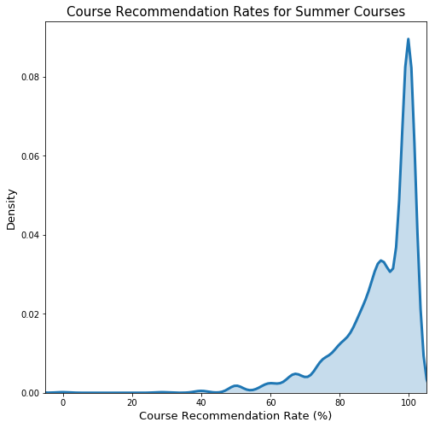
Density Distributions of Professor and Course Recommendations
Notes:
Alex
Summer courses and professors are generally well received.

Slide 20
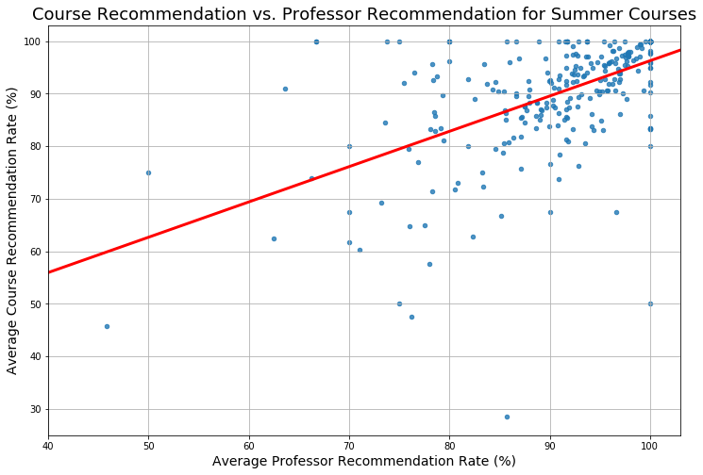
Relationship between Professor and Course Recommendation
Slope: 0.6718, Intercept: 29.0903
r value: 0.5520, p value: 2.2655e-24
Notes:
alex

Slide 21
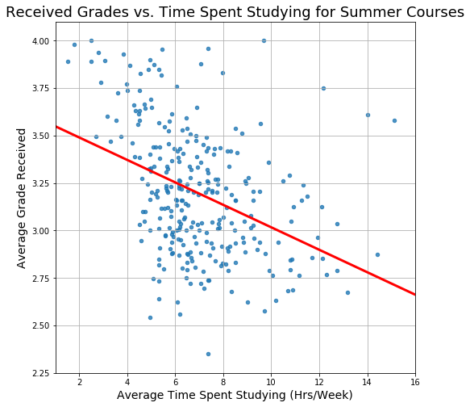
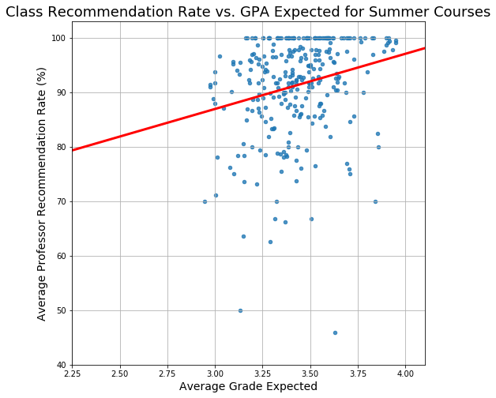
Additional Relationships
Slope: -0.0591, Intercept: 3.6084
r value: -0.3927, p value: 4.7015e-12
Slope: 10.1321, Intercept: 56.5121
r value: 0.2329, p value: 6.6236e-5
Notes:
Alex
Most of the other relationships, like the ones above, did not have strong correlations

Slide 22
Conclusion
There is very little difference in difficulty between summer and non-summer courses: GPA’s are roughly equal
However, summer class-sizes are smaller
Students spend slightly more time on summer-courses, but many students take only 1 summer course/summer session: more summer free time, overall
There’s minimal advantage or risk in summer session. Thus, plan your schedule out like you normally would, it’s basically the same thing!
Notes:
albert

